Slide 1

Questions??
Which attribute choose first?
What should be the order?
How to decide splitting criteria?
How to decide number of child node?
How to measure decision tree quality?

Slide 2
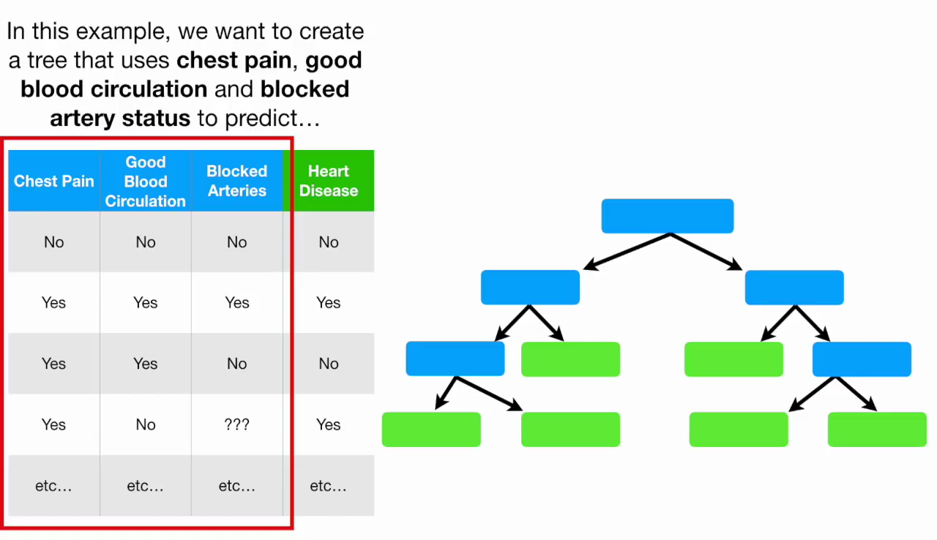

Slide 3
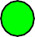
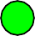
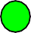
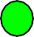
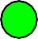
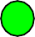
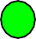
Information Gain
Impurity (informal)
– Measures the level of impurity in a group of examples
13

Slide 4
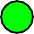
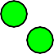
Impurity
Very impure group
Less impure
Minimum impurity
14

Slide 5
Information Gain
We want to determine which attribute in a given set of training feature vectors is most useful for discriminating between the classes to be learned.
Information gain tells us how important a given attribute of the feature vectors is.
We will use it to decide the ordering of attributes in the nodes of a decision tree.
18

Slide 6
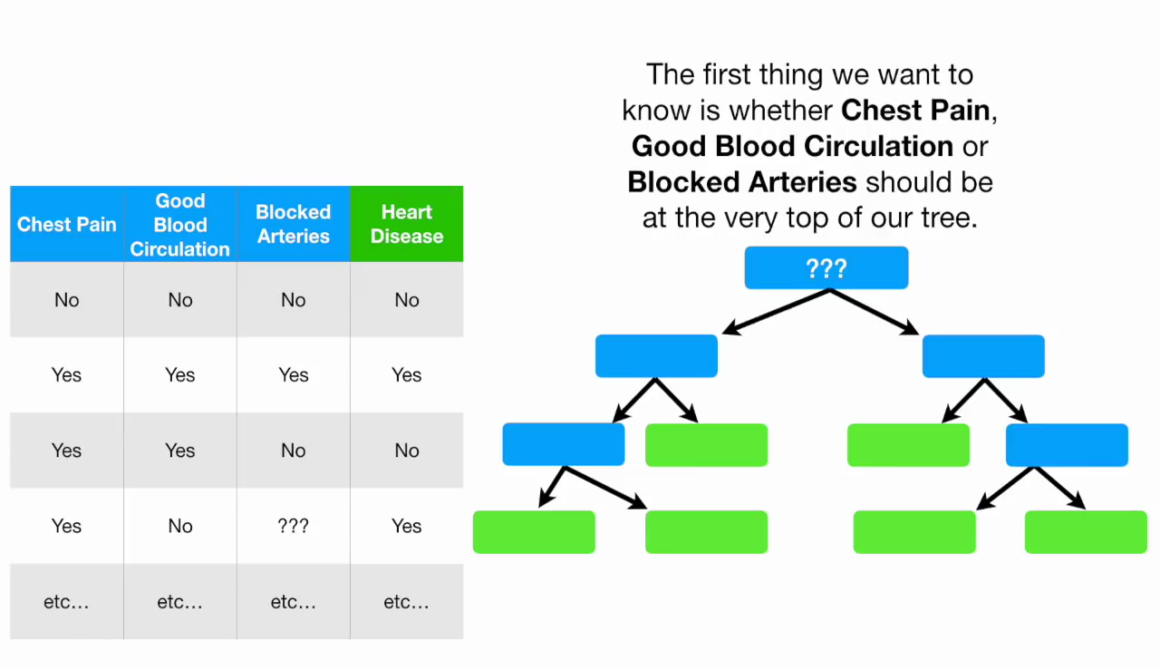

Slide 7
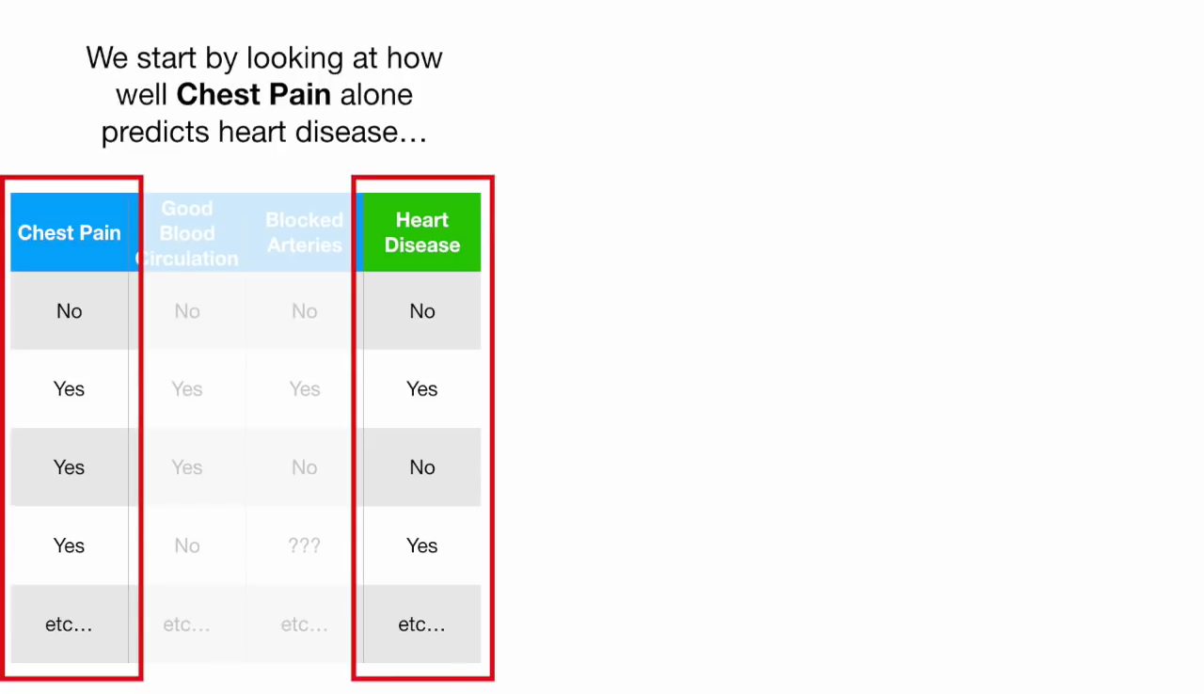

Slide 8
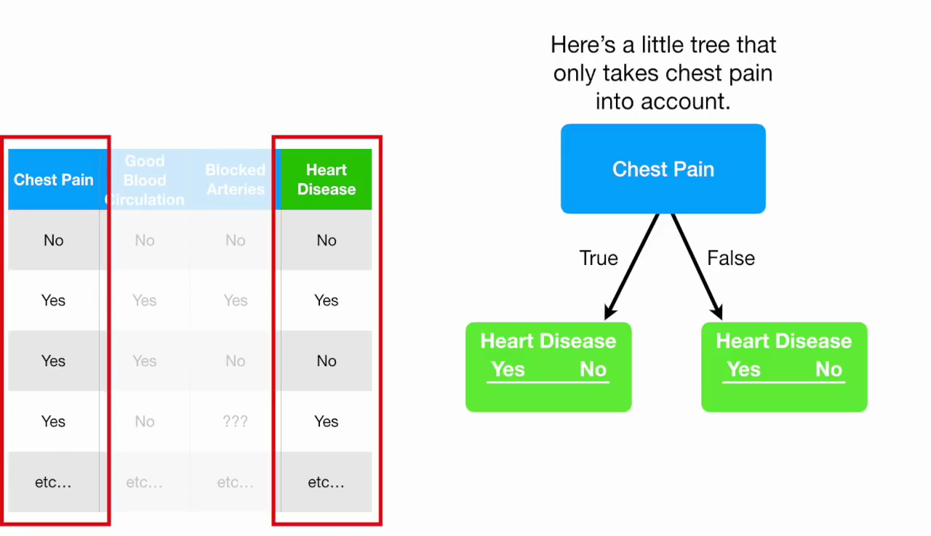

Slide 9
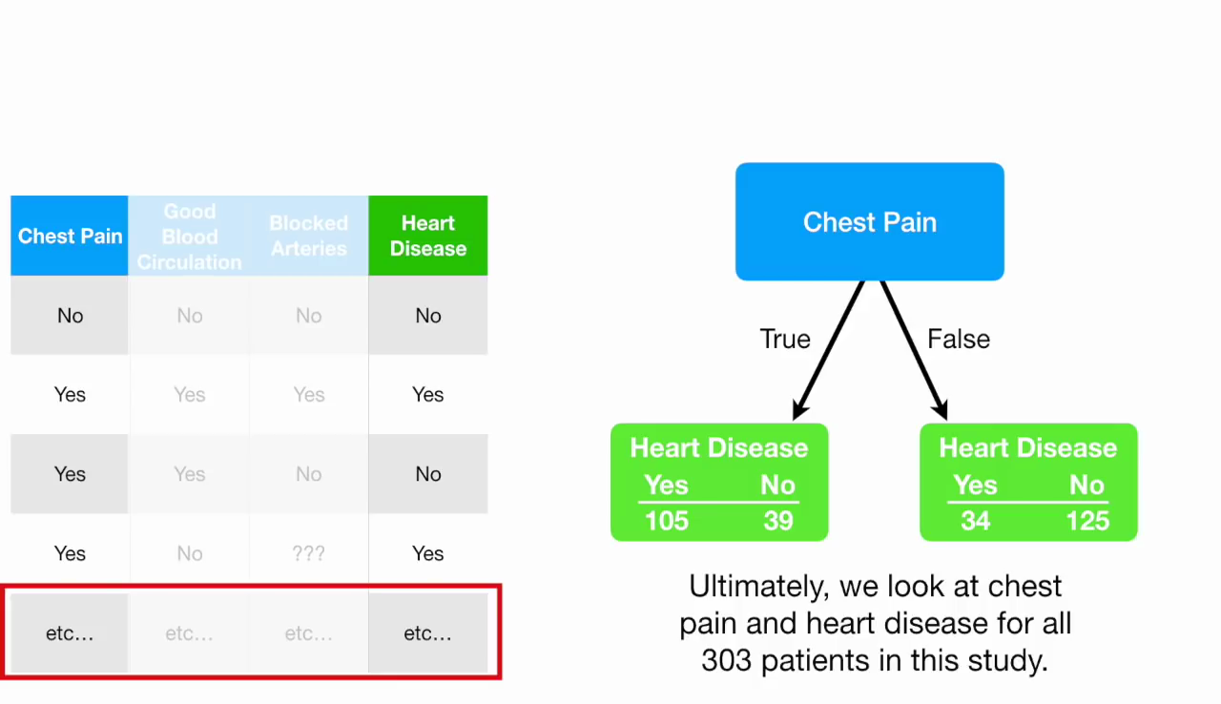

Slide 10
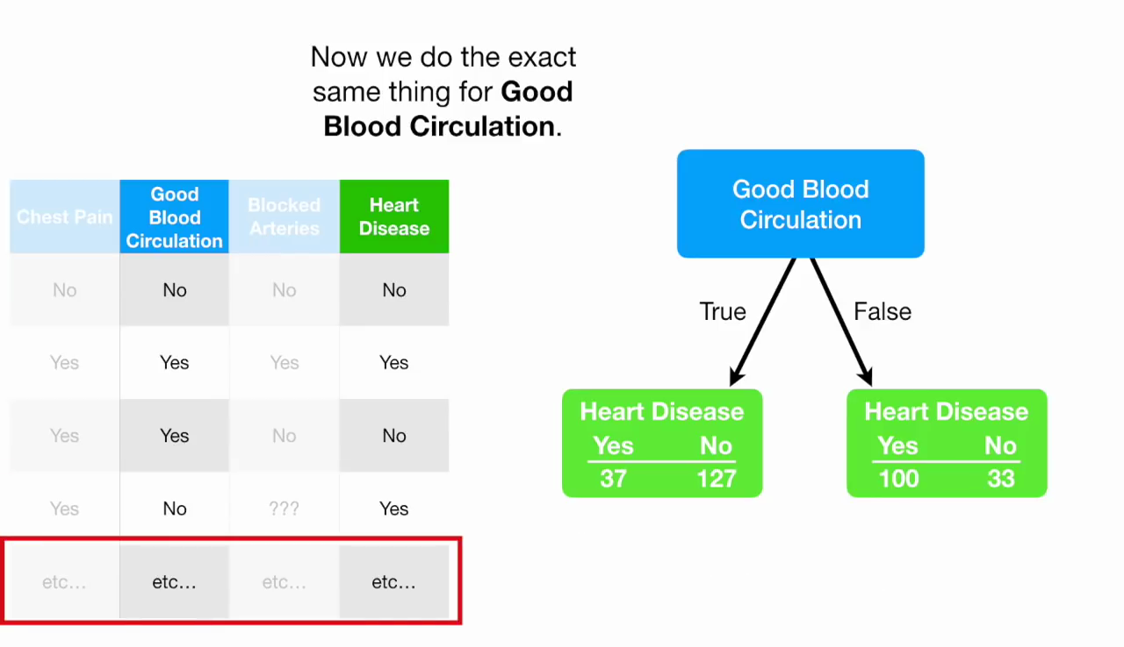

Slide 11
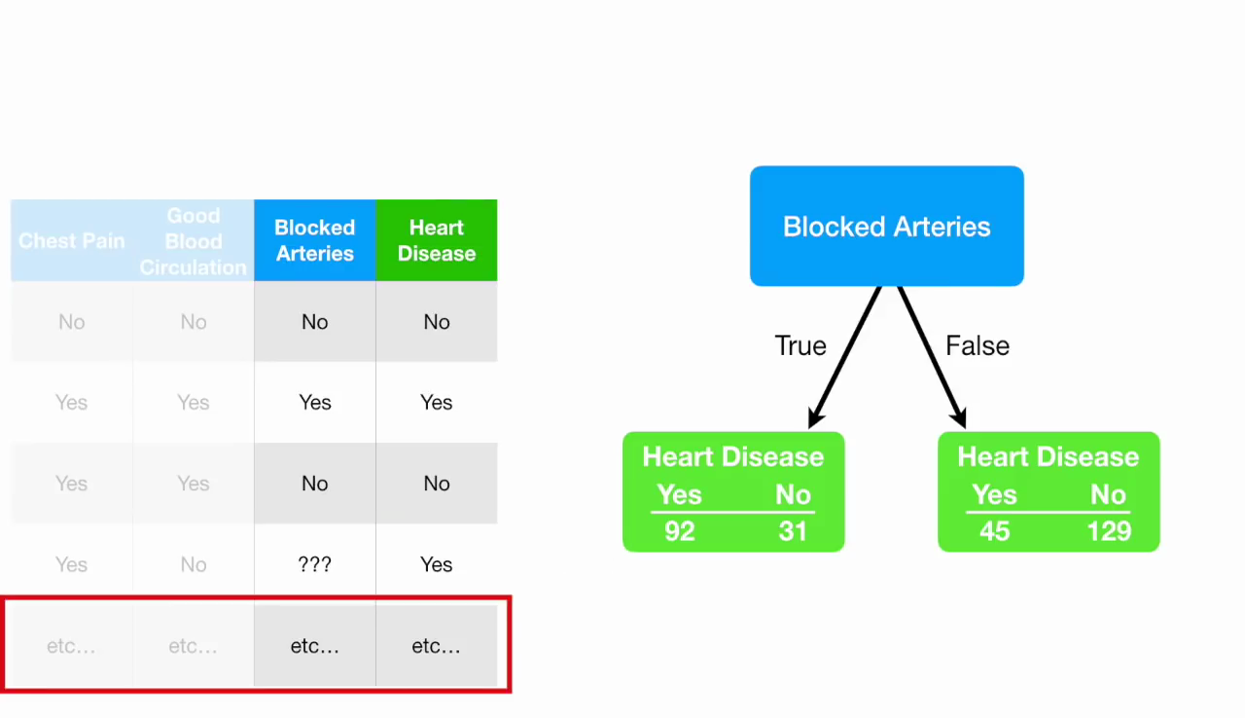

Slide 12
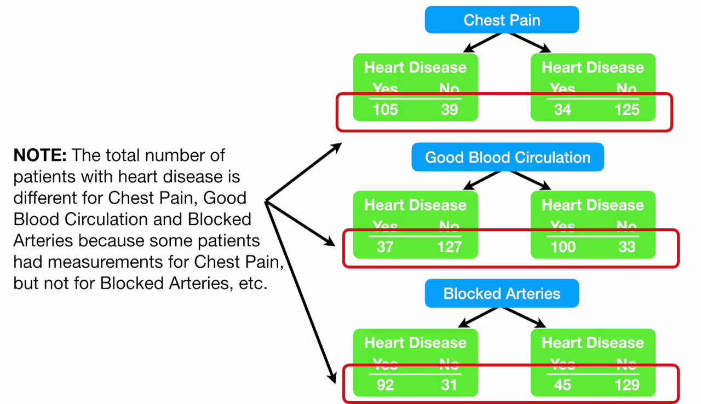

Slide 13
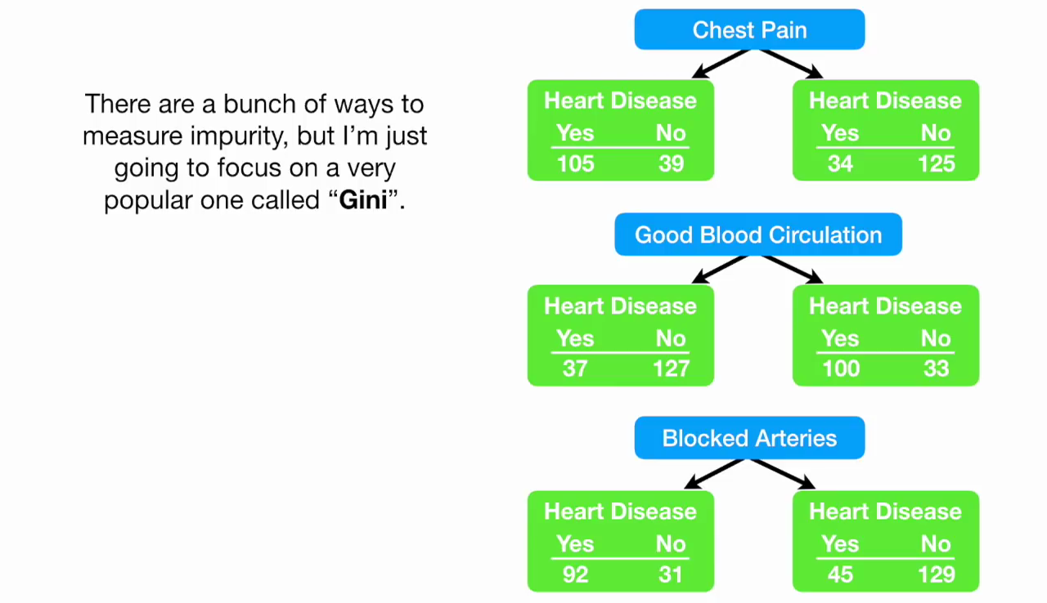

Slide 14
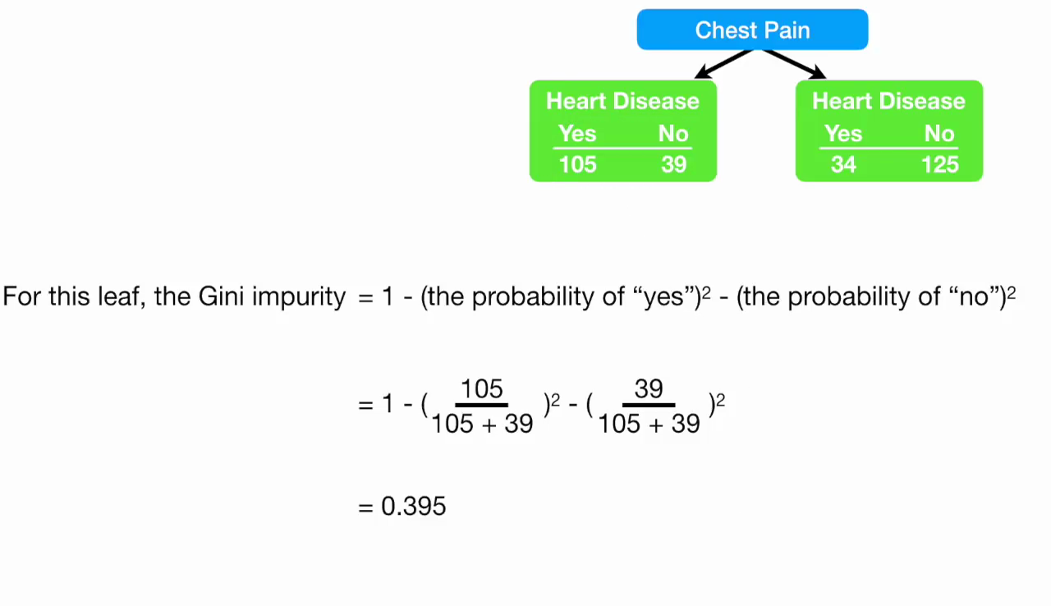

Slide 15
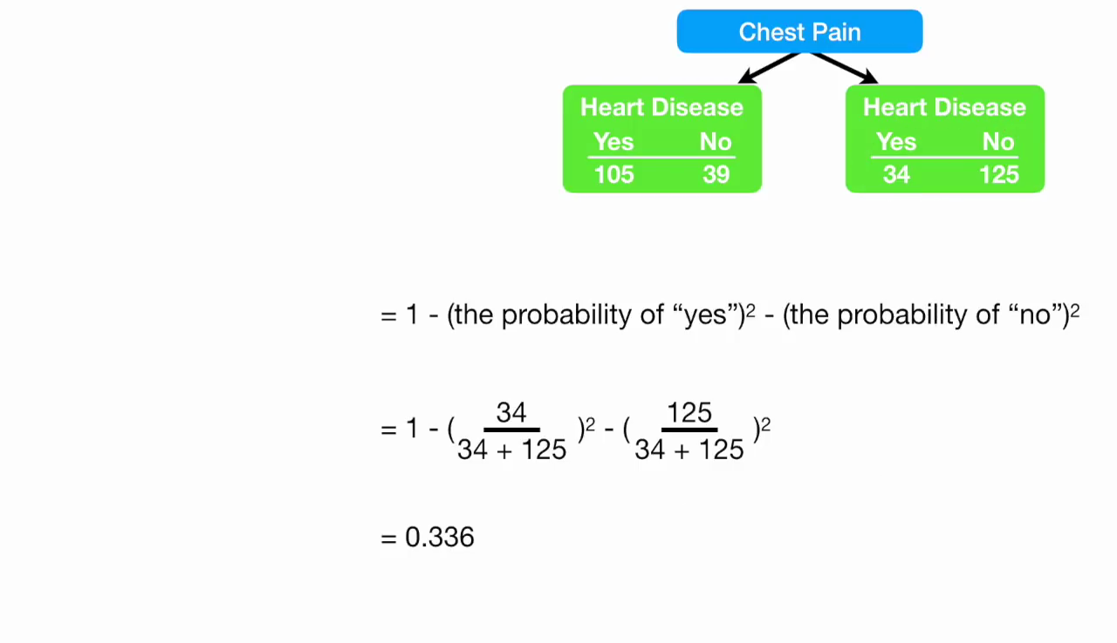

Slide 16
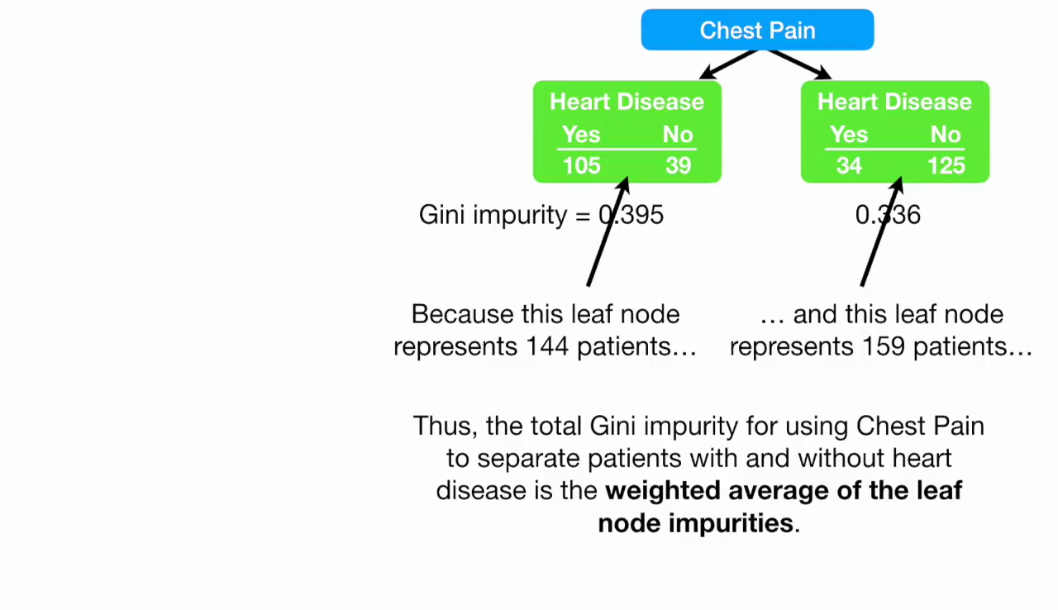

Slide 17
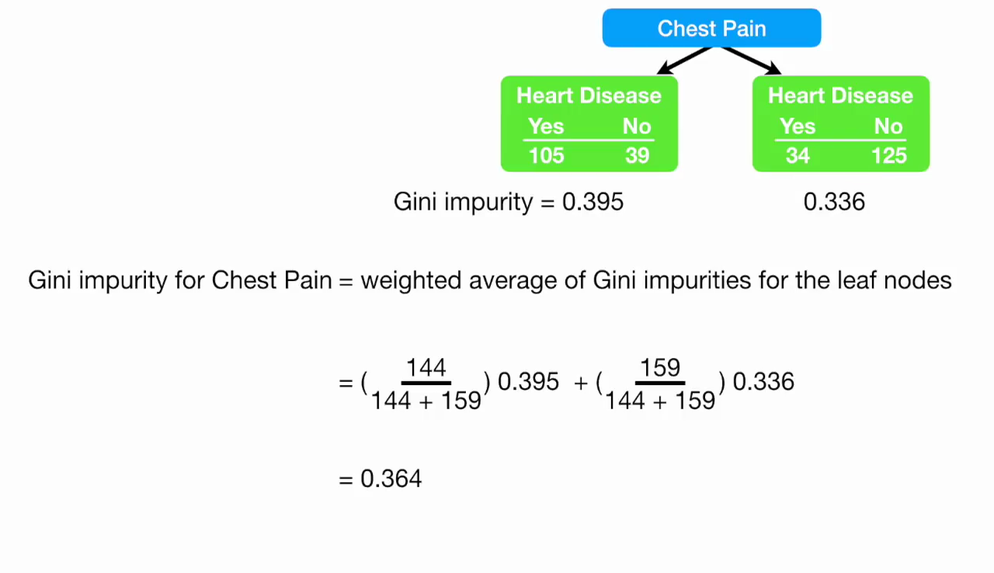

Slide 18
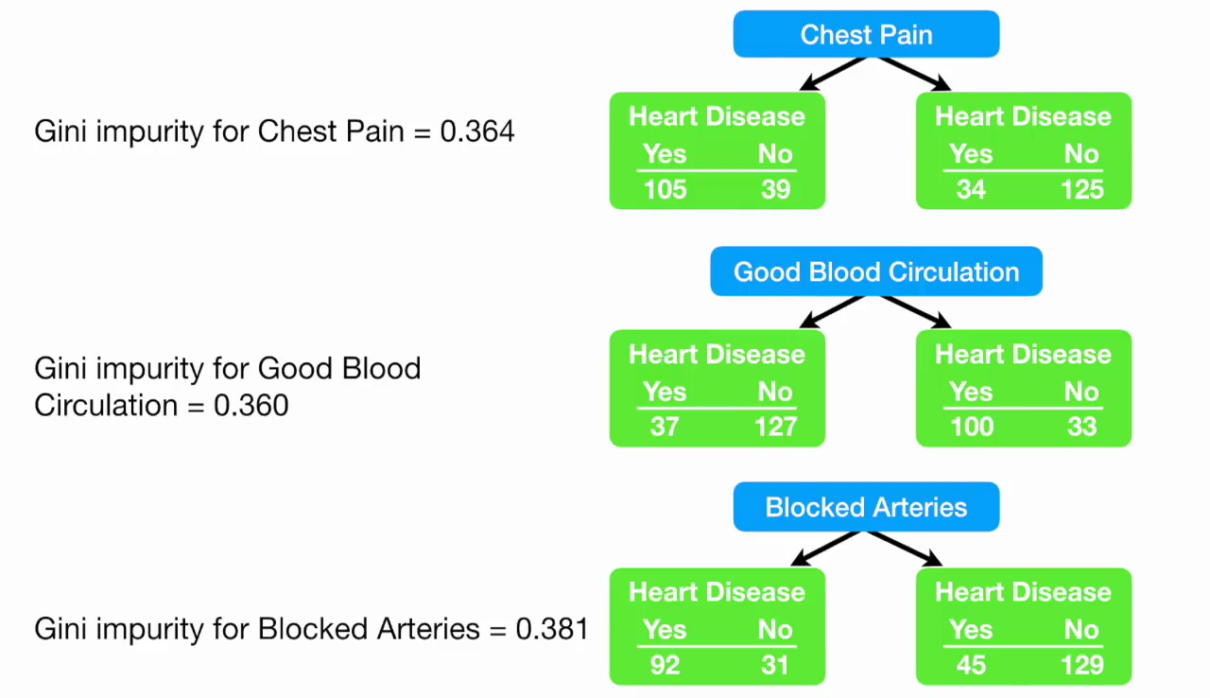

Slide 19
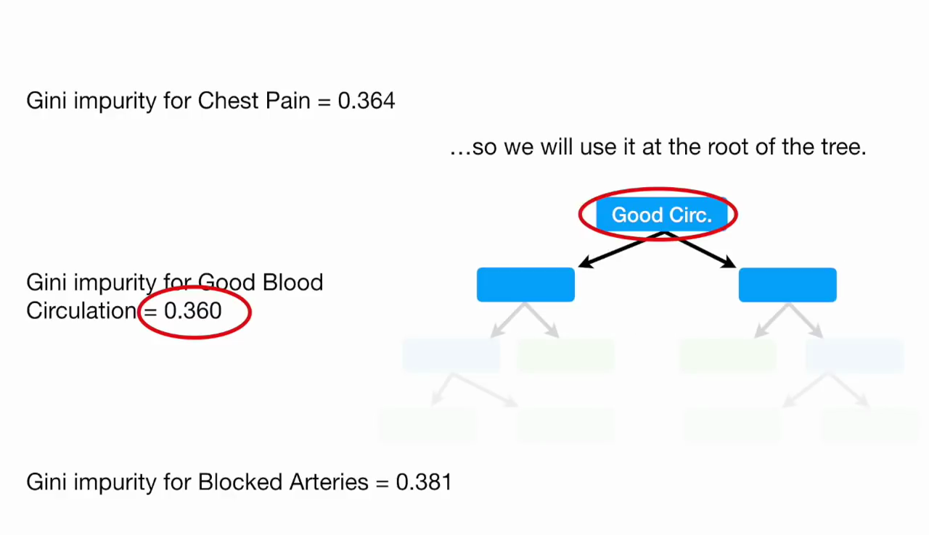

Slide 20
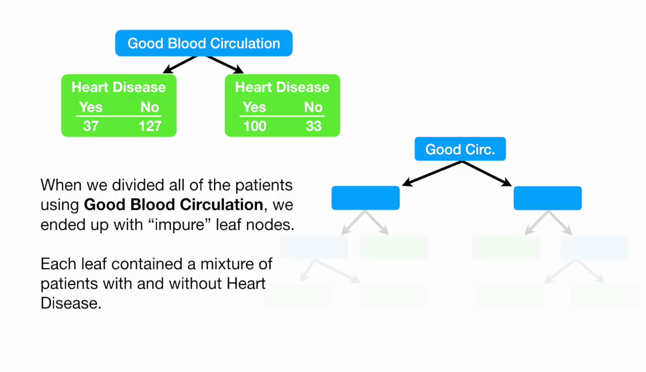

Slide 21
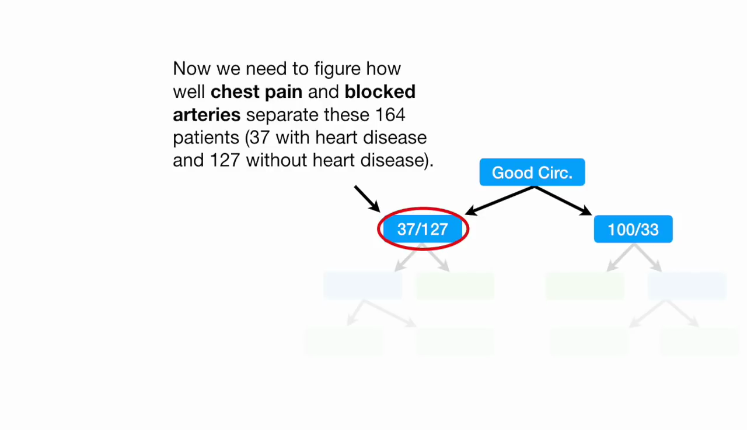

Slide 22
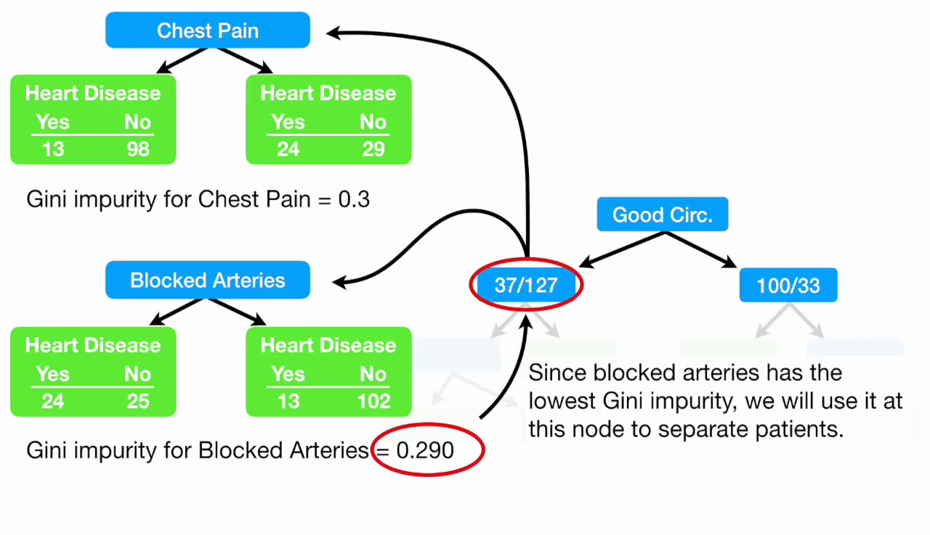

Slide 23
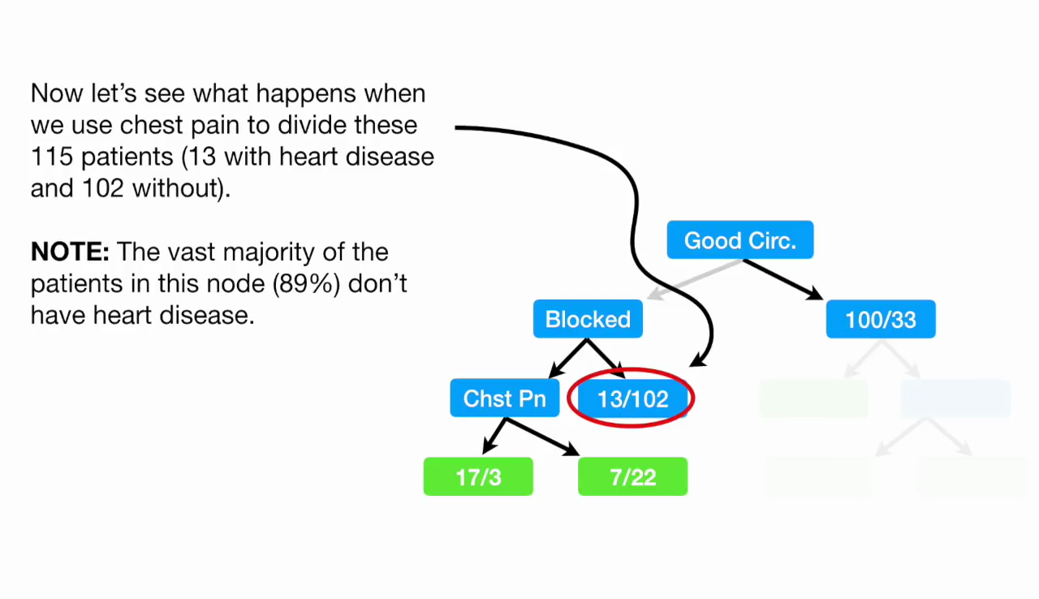

Slide 24
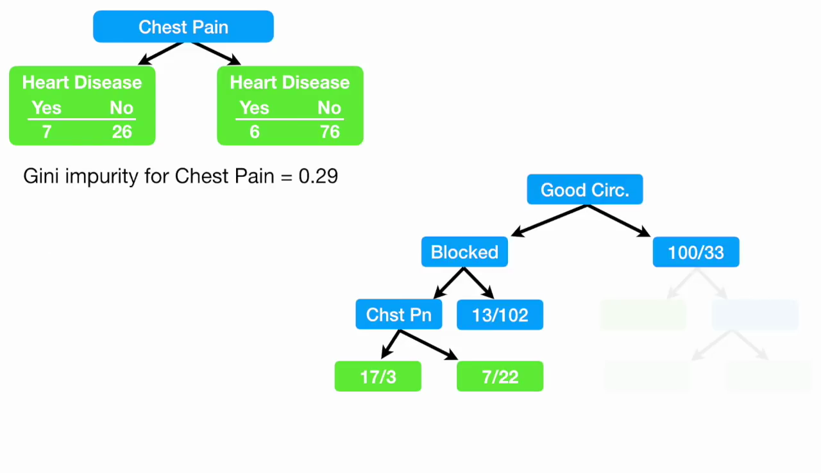

Slide 25
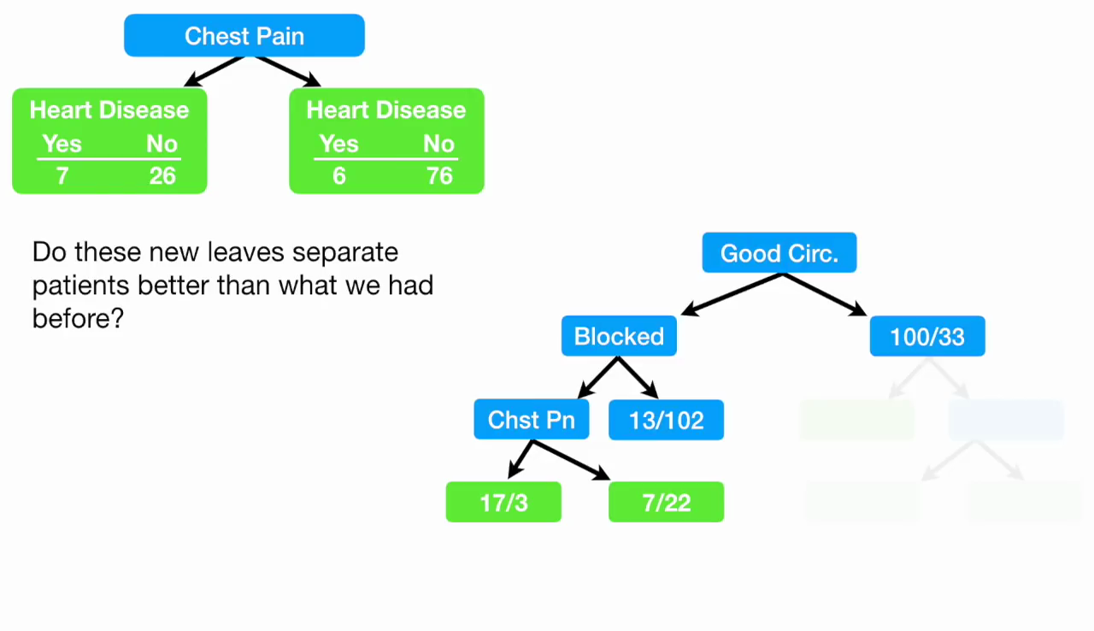

Slide 26
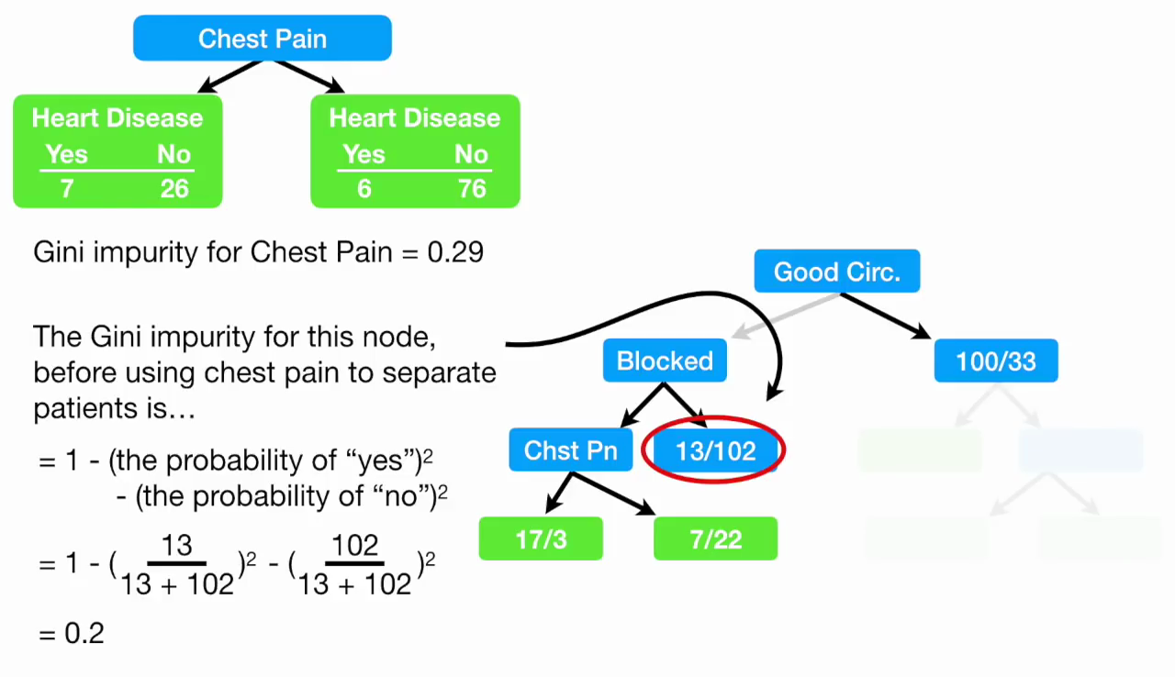

Slide 27
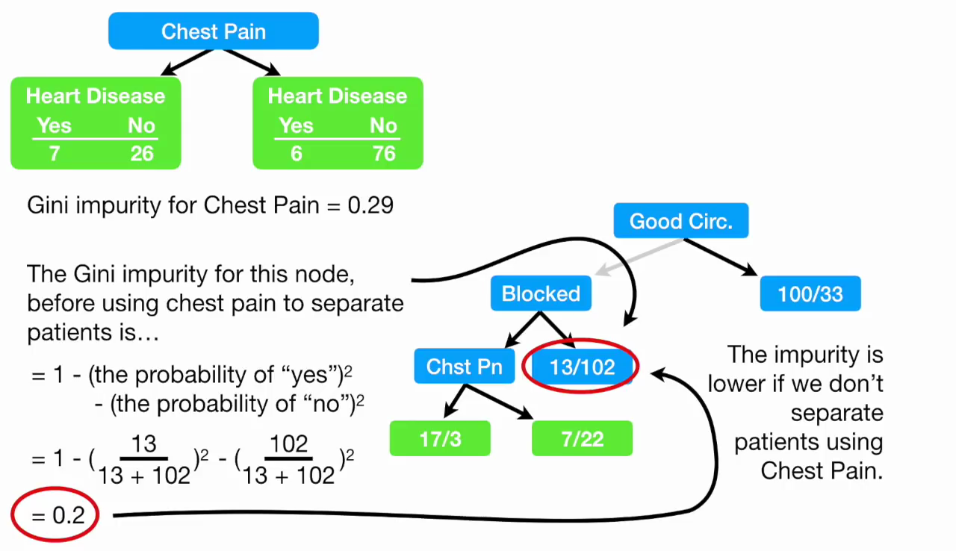

Slide 28
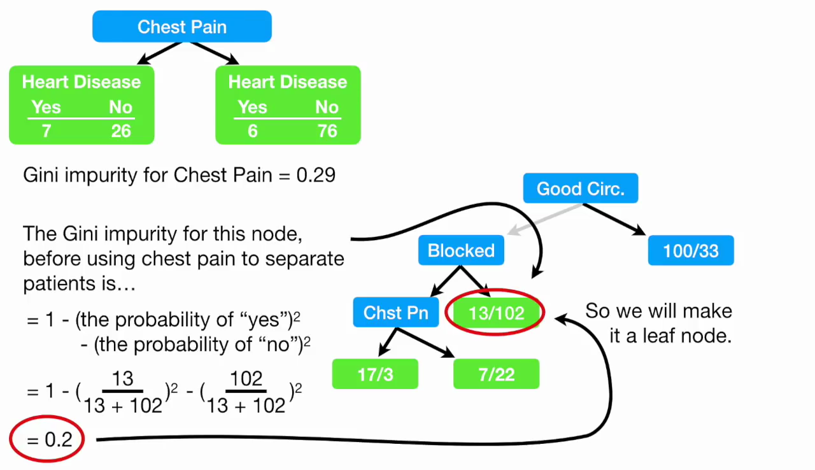

Slide 29
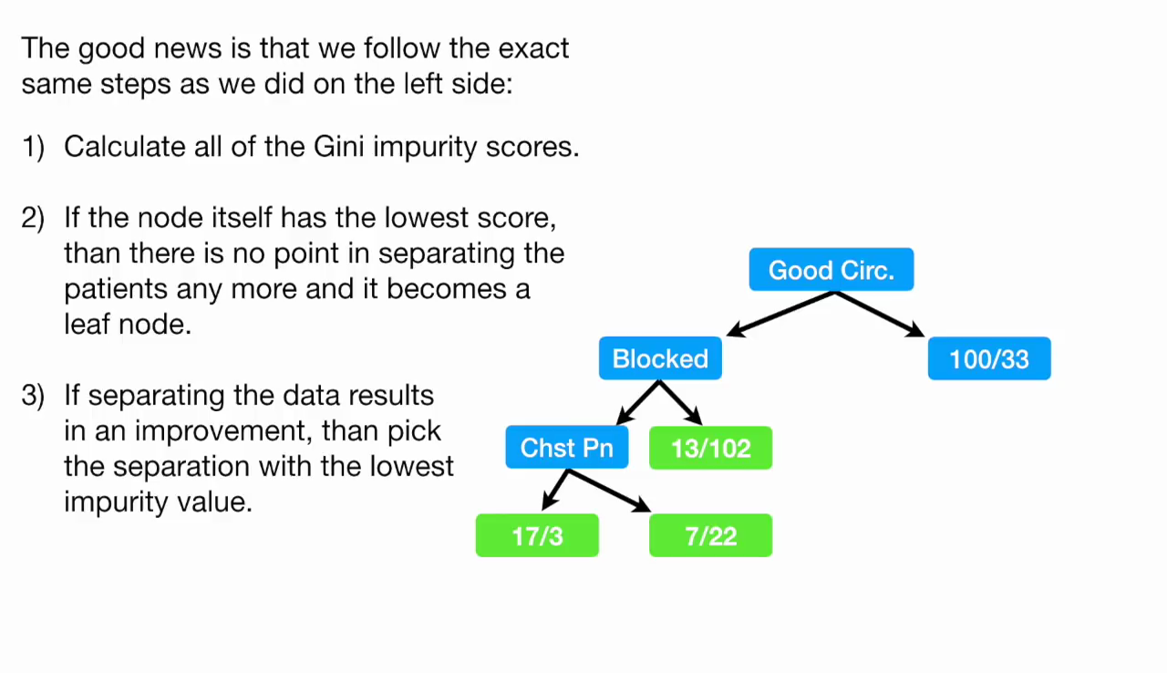

Slide 30
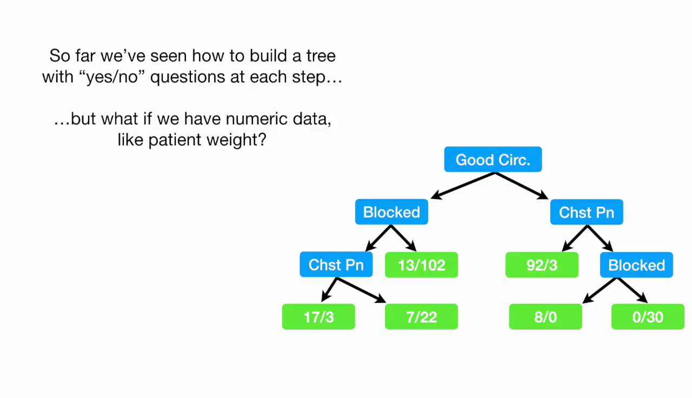

Slide 31
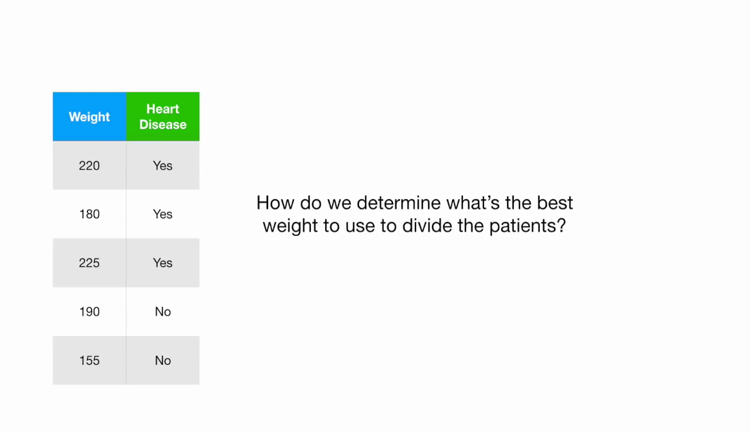

Slide 32
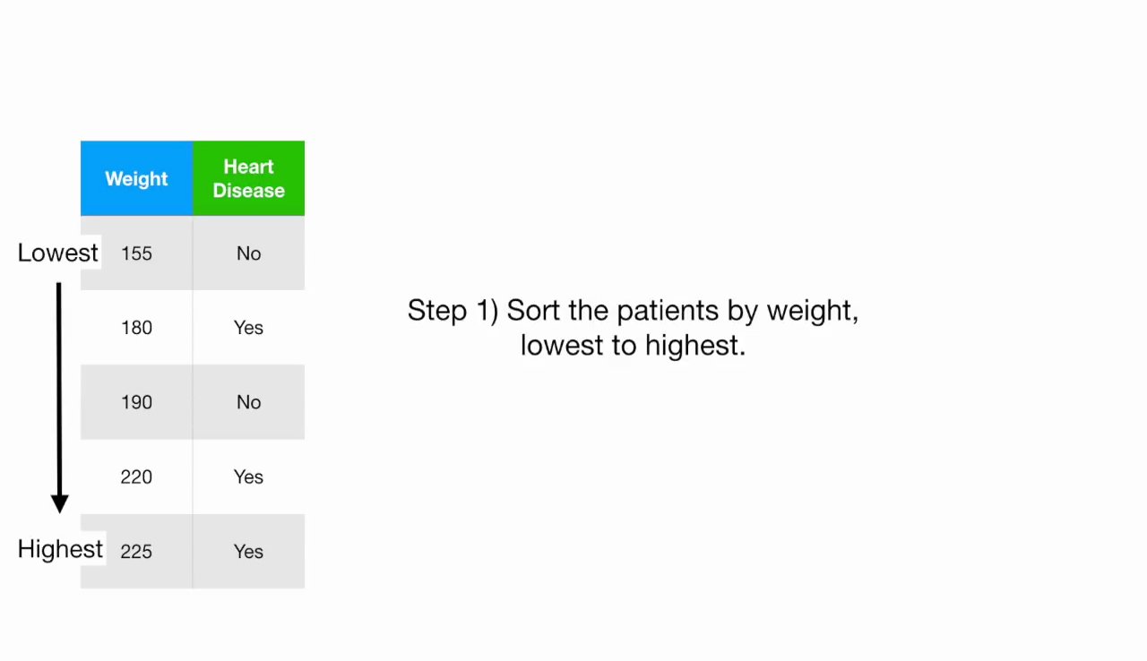

Slide 33
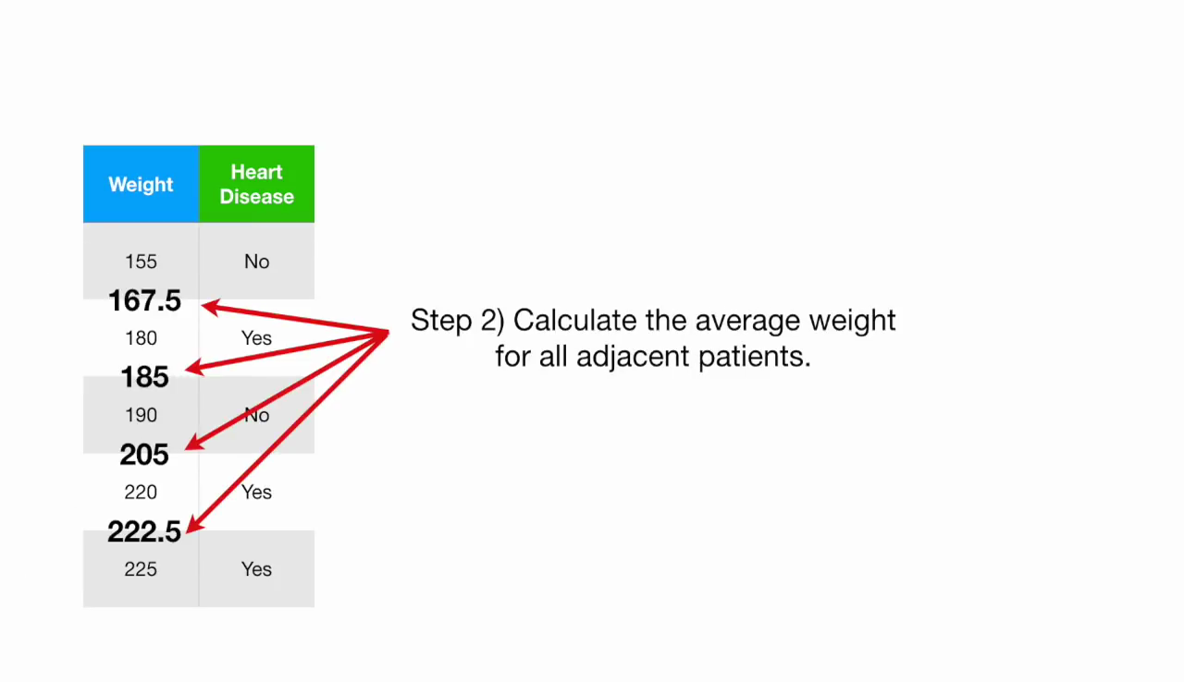

Slide 34
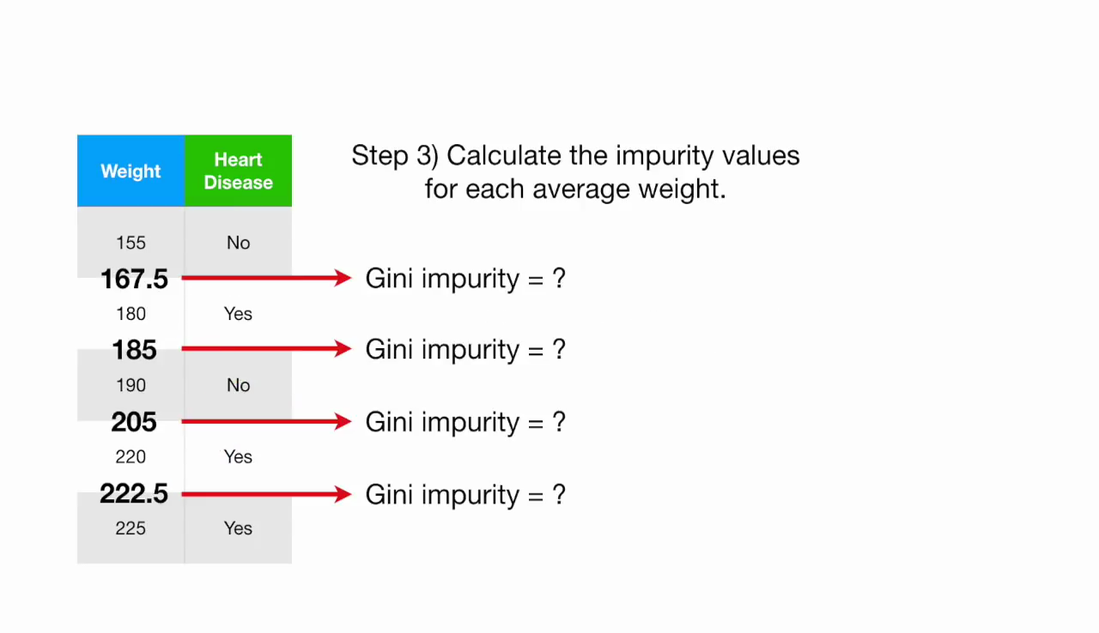

Slide 35
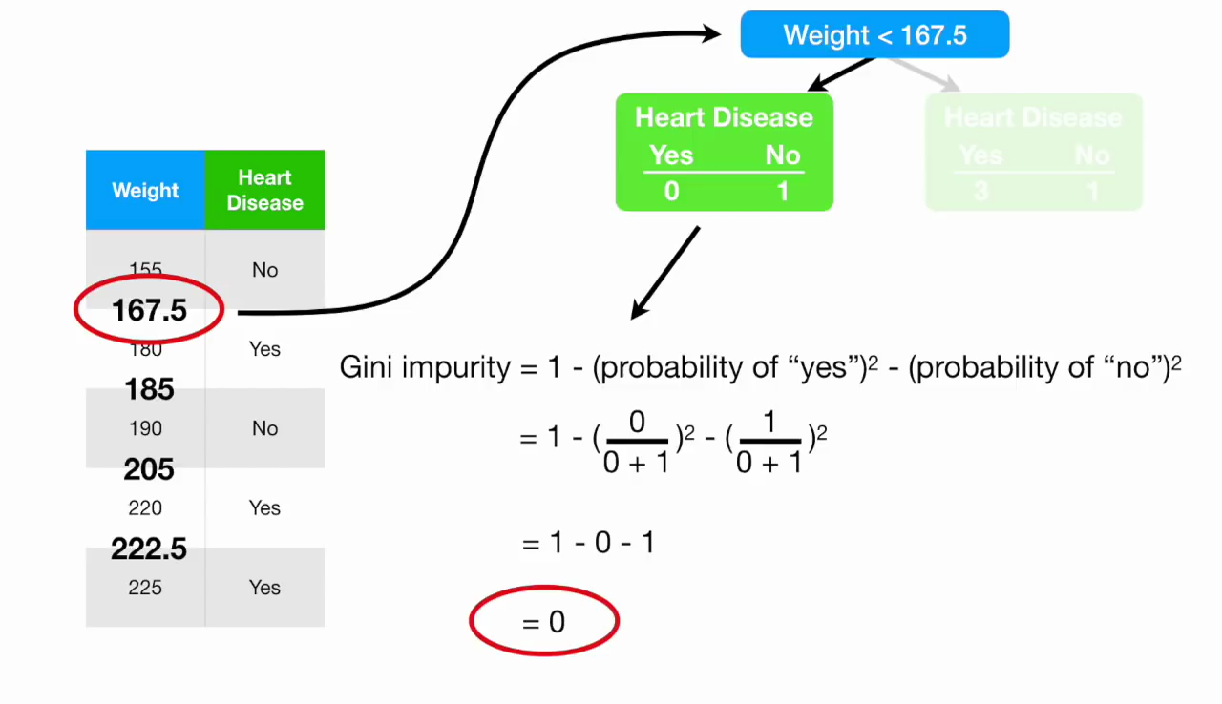

Slide 36
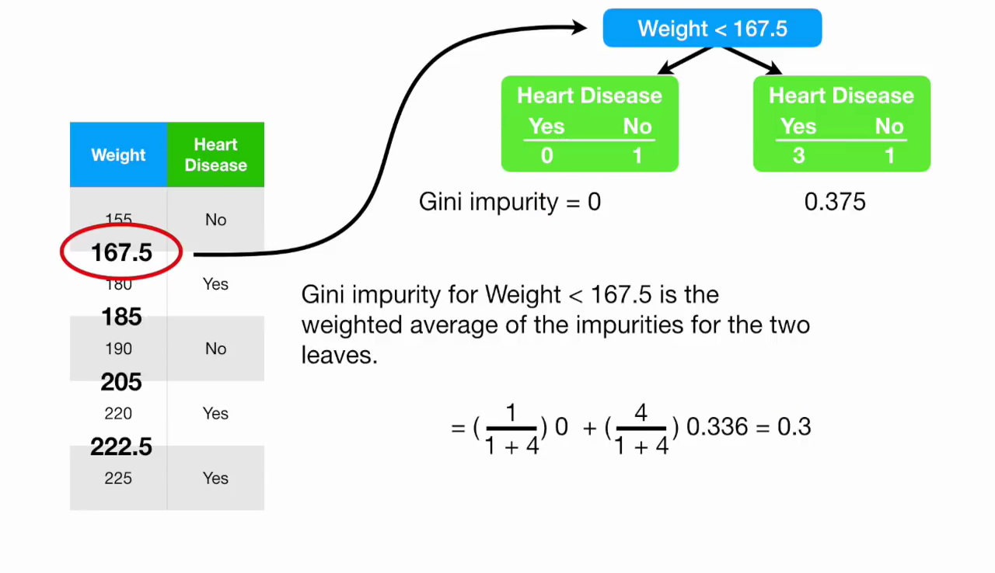

Slide 37
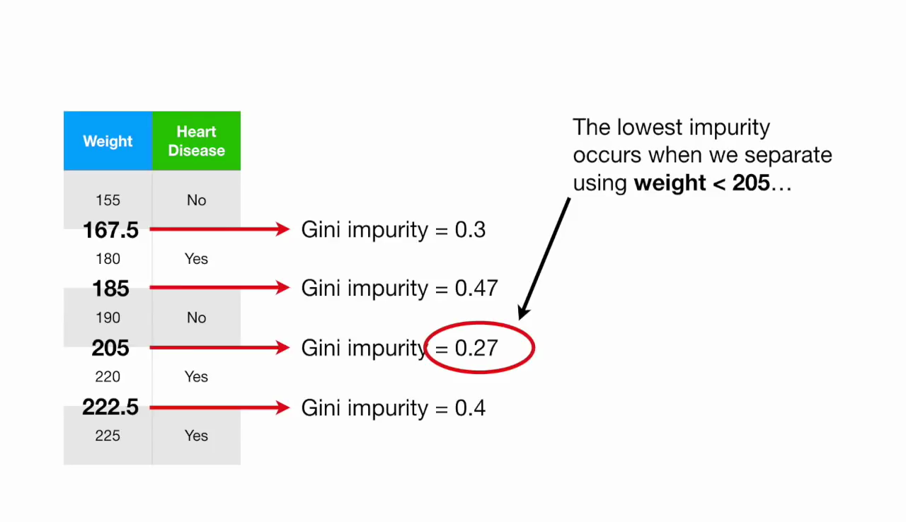

Slide 38
Measure of Impurity: GINI
Gini Index for a given node t :
(NOTE: p( j | t) is the relative frequency of class j at node t).
Maximum (1 - 1/n_{c}) when records are equally distributed among all classes, implying least interesting information
Minimum (0.0) when all records belong to one class, implying most interesting information

Slide 39
Examples for computing GINI
P(C1) = 0/6 = 0 P(C2) = 6/6 = 1
Gini = 1 – P(C1)² – P(C2)² = 1 – 0 – 1 = 0
P(C1) = 1/6 P(C2) = 5/6
Gini = 1 – (1/6)² – (5/6)² = 0.278
P(C1) = 2/6 P(C2) = 4/6
Gini = 1 – (2/6)² – (4/6)² = 0.444

Slide 40
Splitting Based on GINI
Used in CART
When a node p is split into k partitions (children), the quality of split is computed as,
where, n_{i} = number of records at child i,
n = number of records at node p.

Slide 41
Binary Attributes: Computing GINI Index
Splits into two partitions
Effect of Weighing partitions:
Larger and Purer Partitions are sought for.
B?
Yes
No
Node N1
Node N2
Gini(N1) = 1 – (5/7)² – (2/7)² = 0.408
Gini(N2) = 1 – (1/5)² – (4/5)² = 0.32
Gini(Children) = 7/12 * 0.408 + 5/12 * 0.32 = 0.371

Slide 42
Categorical Attributes: Computing Gini Index
For each distinct value, gather counts for each class in the dataset
Use the count matrix to make decisions
Multi-way split
Two-way split
(find best partition of values)

Slide 43
Alternative Splitting Criteria based on INFO
Entropy at a given node t:
(NOTE: p( j | t) is the relative frequency of class j at node t).
Measures homogeneity of a node.
Maximum (log n_{c}) when records are equally distributed among all classes implying least information
Minimum (0.0) when all records belong to one class, implying most information
Entropy based computations are similar to the GINI index computations

Slide 44
Examples for computing Entropy
P(C1) = 0/6 = 0 P(C2) = 6/6 = 1
Entropy = – 0 log 0 – 1 log 1 = – 0 – 0 = 0
P(C1) = 1/6 P(C2) = 5/6
Entropy = – (1/6) log₂ (1/6) – (5/6) log₂ (1/6) = 0.65
P(C1) = 2/6 P(C2) = 4/6
Entropy = – (2/6) log₂ (2/6) – (4/6) log₂ (4/6) = 0.92

Slide 45
Splitting Based on INFO...
Information Gain:
Parent Node, p is split into k partitions;
n_{i} is number of records in partition i
Measures Reduction in Entropy achieved because of the split. Choose the split that achieves most reduction (maximizes GAIN)
Used in ID3 and C4.5
Disadvantage: Tends to prefer splits that result in large number of partitions, each being small but pure.

Slide 46
Entropy: a common way to measure impurity
∑− p_{i} log₂ p_{i}
Entropy =
i
p_{i} is the probability of class i
Compute it as the proportion of class i in the set.
Entropy comes from information theory. The higher the entropy the more the information content.
What does that mean for learning from examples?
15
Based on slide by Pedro Domingos

Slide 47
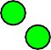
2-Class Cases:
What is the entropy of a group in which all examples belong to the same class?
– entropy = - 1 log₂1 = 0
not a good training set for learning
Minimum impurity
What is the entropy of a group with 50% in either class?
– entropy = -0.5 log₂0.5 – 0.5 log₂0.5 =1
Maximum impurity
good training set for learning
16

Slide 48
Calculating Information Gain
Information Gain =
entropy(parent) – [average entropy(children)]
child
−^{⎛ 13} ×log ^{13 ⎞} − ^{⎛ 4} ×log
^{4 ⎞} = 0.787
⎜
entropy 17
÷
÷
⎝
2
17
⎠ ⎝
⎜17
2
17
⎠
Entire population (30 instances)
17 instances
child entropy
−^{⎛ 1} ×log
^{1 ⎞} − ^{⎛12} ×log ^{12 ⎞} = 0.391
÷ ÷
⎜13
2
13
⎜ 13
2
13
⎝
⎠ ⎝
⎠
parent
−^{⎛ 14} ×log ^{14 ⎞} − ^{⎛ 16} ×log ^{16 ⎞} = 0.996
⎜
entropy 30
2
÷ ÷
⎝
30
⎠ ⎝
⎜ 30
2
30
⎠
13 instances
^{⎛ 17} × 0.787⎞ + ^{⎛ 13} × 0.391⎞ = 0.615
(Weighted) Average Entropy of Children = ⎜ ₃₀
÷ ÷
⎝
Information Gain= 0.996 - 0.615 = 0.38
⎠ ⎝
⎜ 30
⎠
21

Slide 49
How to Find the Best Split
Before Splitting:
M0
A?
B?
Yes
No
Yes
No
Node N1
Node N2
Node N3
Node N4
M1
M2
M3
M4
M12
M34
Gain = M0 – M12 vs M0 – M34

